Slide 1
Fetal Health Classifier
By: Andrea Hannah and Tara Linney for MSDS565
March 20, 2023

Slide 2
Presentation
Introduction
The Data
Exploratory Data Analysis
Methodology: Algorithms
Evaluation metrics
Results
Conclusion
Contents

Slide 3
Introduction
Notes:
Introduct

Slide 4
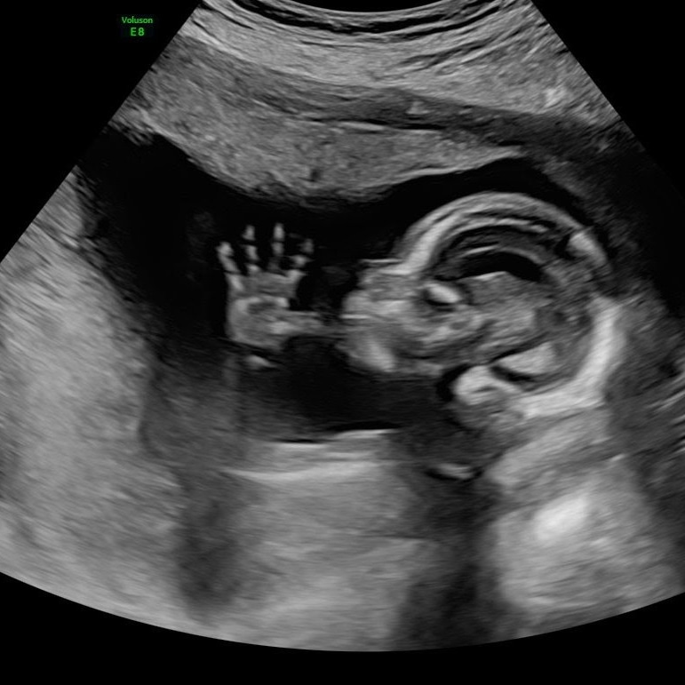
Problem:
Fetal Health
Fetal health of a baby in utero has an impact on child and maternal mortality.
Child mortality is a concern in countries all over the world.
By analyzing and classifying fetal health, countries can end preventable deaths of newborns and babies under the age of 5 years old.
This issue of fetal health is something that affects both the fetus and the maternal health of its carrier. Thus, by solving this problem, we could save not just one life, but two.
Notes:
A

Slide 5
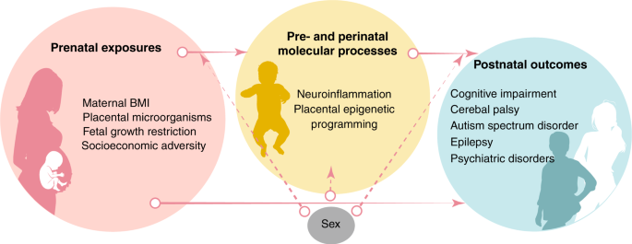
Lifecycle of Fetal Health
Source: https://www.nature.com/articles/s41390-020-01236-1
Notes:
A

Slide 6
Project Goals
Goal: We built machine learning models to predict fetal health using uterine contraction and other clinical features detectable by observing vitals for expectant mothers.
Plan: We built two supervised learning models to classify patients as having a fetus with normal health or at-risk health. We used pairwise correlation to find the most critical feature to use in our model as a predictor variable, prolonged_decelerations.
Random Forest Classifier Model & Decision Tree Classifier Model
Metrics: Our model performance metrics included: accuracy, precision, recall, and F1-score to determine if our predictive models were successful and determine which model performed the best.
Notes:
A

Slide 7
The Data
Notes:
Introduct

Slide 8
Dataset
Variables included:
baseline value
accelerations
fetal movement
uterine contractions
light decelerations
severe decelerations
prolonged decelerations
abnormal short term variability
mean value of short term variability
percentage of time with abnormal long term variability
Data sourced from Kaggle. All variables were float numeric values, and there were no missing values.
2126 measurements
Notes:
T

Slide 9
Exploratory Data Analysis
Notes:
Introduct

Slide 10
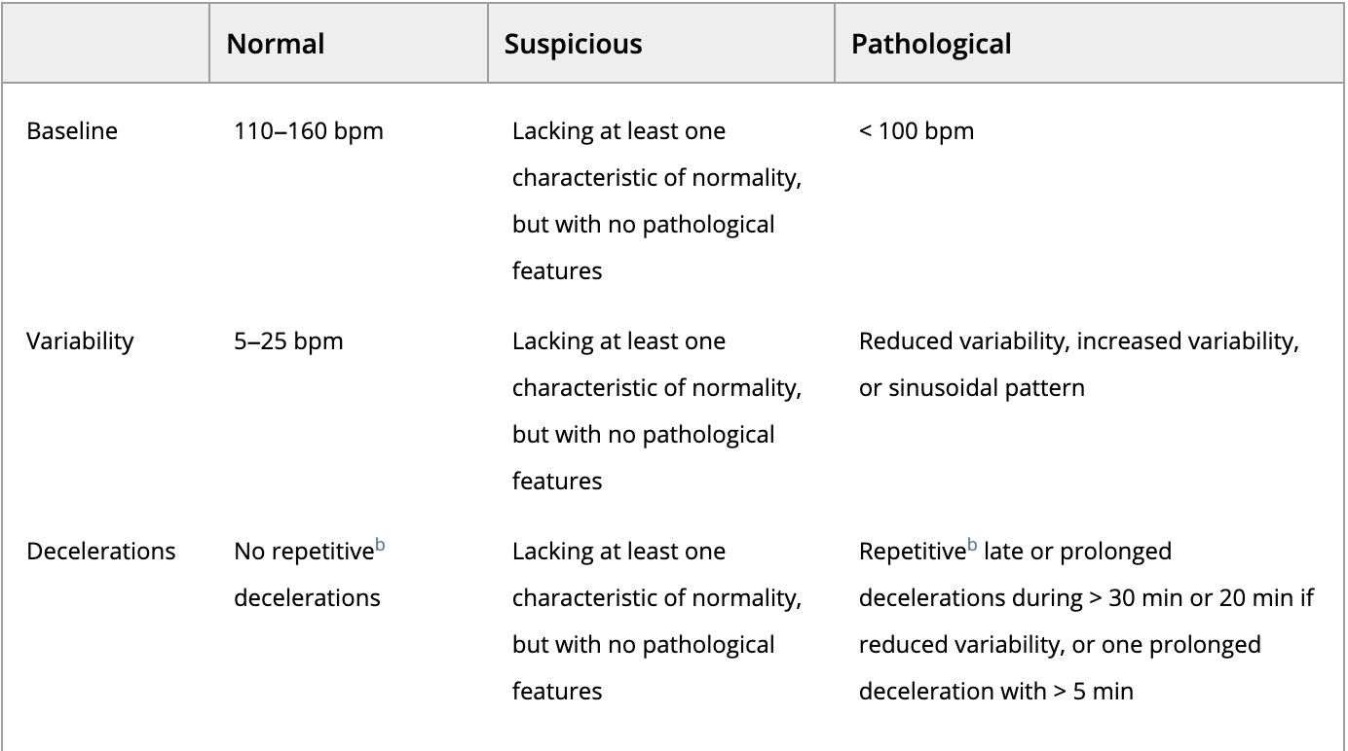
Fetal Health Values
1 - Normal
2 - Suspect
3 - Pathological
Source: https://obgyn.onlinelibrary.wiley.com/doi/10.1016/j.ijgo.2015.06.020
Notes:
T

Slide 11
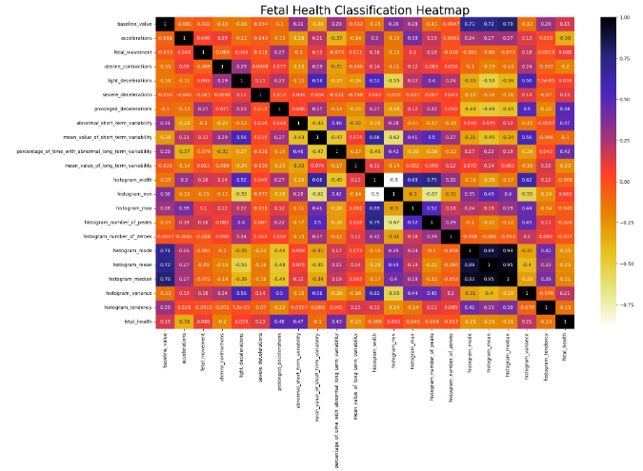
With any research using this dataset, we would drop the highly correlated features shown in this heatmap from the model. However, we will focus on prolonged decelerations for the purpose of group research.
Decision Tree Classifier
Notes:
A

Slide 12
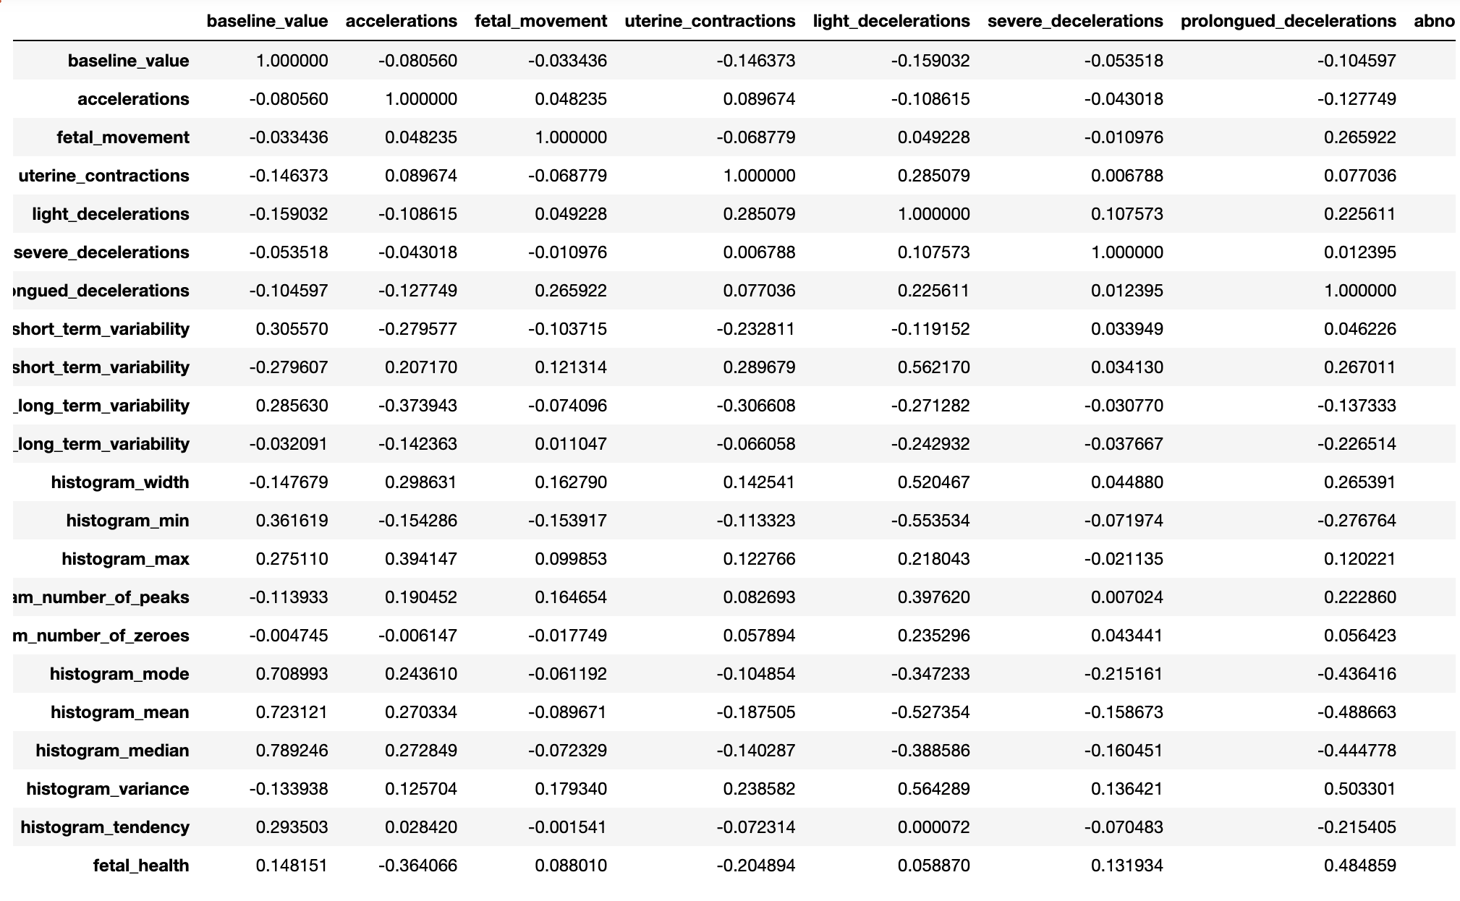
Fetal Health correlations
Notes:
T

Slide 13
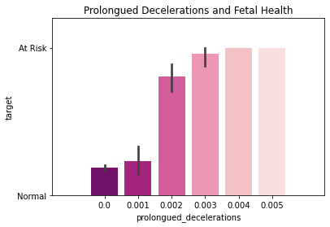
Examining relationship between Prolonged Decelerations and Fetal Health
Notes:
T

Slide 14
Methodology
Notes:
Introduct

Slide 15
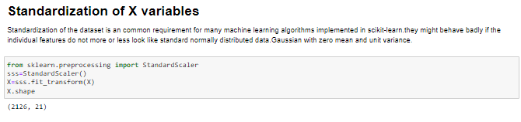
Preprocessing
In preparation for building our chosen models, we found that we had no missing values to impute and that all values were numeric.
However, we did need to classify Fetal Health ranges as Normal or At Risk with the scale given in our data set. We assigned 1 as Normal, and 2 or 3 values as At-Risk.
Finally, we provided scalar standardization for the predictor variable, X.
Notes:
A

Slide 16
Methodology Selection:
Decision Trees
Decision Trees Classifier is a supervised machine learning algorithm, which uses labeled data sets to train algorithms that classify data or predict outcomes accurately. Decision trees uses a tree-like flowchart model of decisions and the corresponding possible consequences. A decision tree consists of three types of nodes:
1. Root Node - represents the feature all other nodes split from;
2. Decision Nodes - represent a test on a feature or attribute for a decision to be made on. As the tree depth increases, the loss entropy should decrease and the information gain should increase until we end up with a pure leaf or end node
3. Leaf/End Nodes - represents the outcome with reduced uncertainty
It is advantageous to use decision trees because they are interpretable and understandable after brief explanation.A disadvantage is that calculation can become complex if many values are uncertain. Since our data has no missing values, there is little to no uncertainty to impact decision trees as a selected model. Accuracy of the decision tree model is increased when the depth increases.
Notes:
A

Slide 17
Methodology Selection:
Random Forest
Random Forest Classifier is a supervised machine learning technique consisting of many decision trees.
Random Forest uses ensemble learning to combine many weak classifier to provide solutions for complex problems.
Random Forest is a bagging method that uses a subset of the original dataset to make predictions, which is an advantage to help to limit overfitting, and creates multiple decision trees with a different set of observations.
This classifier involves bootstrapping, which is row and feature sampling with a replacement before training the model.
A disadvantage in using this model is when using one feature, Low Bias and High Variance increases with the depth of the decision trees.
Notes:
T

Slide 18
Methodology Comparison
Decision Tree vs. Random Forest
Decision Trees Classifier
A single decision tree has faster computation
Uses rules to predict from input that is a dataset with features
May experience overfitting if maximum depth reached
Random Forest Classifier
Computation is slower
Randomly selects observations, builds decision trees and averages
May experience overfitting if not enough features selected; otherwise, the bagging method that yields output based on majority vote/ranking fixes overfitting
Notes:
A

Slide 19
Evaluation Metrics
Notes:
Introduct

Slide 20
Method
Accuracy
& F-1:
0.87
Decision Tree Classifier
Notes:
A

Slide 21
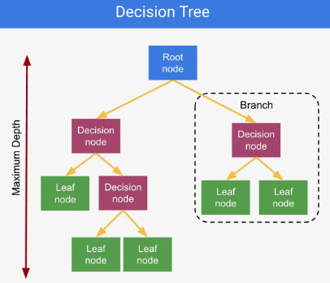
Method
Decision Tree Classifier
Source: https://www.jcchouinard.com/decision-trees-in-machine-learning/.
Showing illustration of Decision Tree structure. Now Let’s see the full decision tree model plot for our data to check depth.
Notes:
A

Slide 22
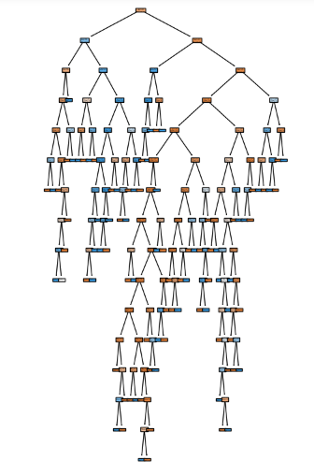
Method
Decision Tree Classifier
Showing illustration of Decision Tree model plot to show depth level of the Decision Tree Classifier was 15.
A greater depth number increases accuracy.
Notes:
A

Slide 23
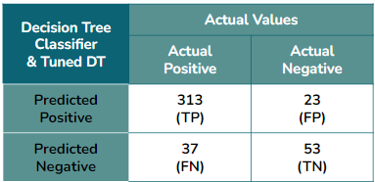
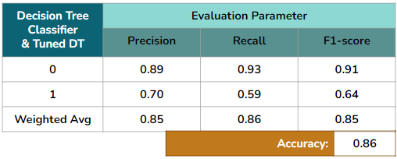
Method
Decision Tree Classifier
There were 313 true positives outcomes, and 23 false positive outcomes for predictions. There were 37 false negatives and 53 true negatives.
The Decision Tree Classifier accuracy was 86%, pre and post hyperparameter tuning. Fetal Health Classification is binary, where Normal = 0 and At-Risk = 1. The model performs better for Normal outcomes.
Notes:
A

Slide 24
Method
Accuracy & F-1:
0.87
Random Forest Classifier
Notes:
T

Slide 25
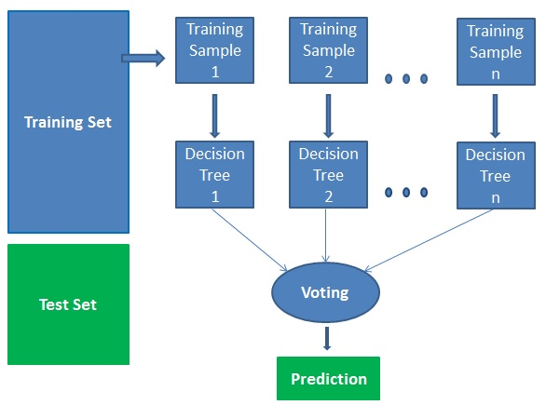
Method
Random Forest Classifier
Source: https://github.com/geekquad/Random-Forest-from-Scratch
Showing illustration of Random Forest Classifier structure. Now Let’s see the full Random Forest Classifier model metrics.
Notes:
T

Slide 26
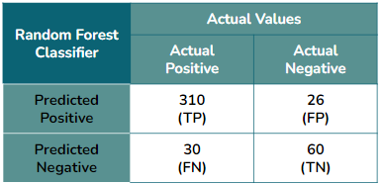
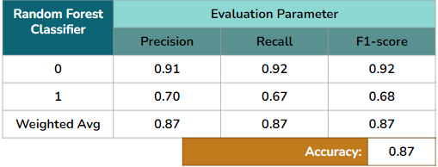
Method
Random Forest Classifier
There were 310 true positives outcomes, and 26 false positive outcomes for positive predictions. There were 30 false negatives and 60 true negatives.
The Random Forest Classifier accuracy was 87% and it has higher performance for the Normal health outcome than At Risk.
Notes:
T

Slide 27
Future Work
Notes:
Introduct

Slide 28
Missing Information
Demographics
Stage of pregnancy during which measurements were taken
Number of fetuses in utero
Gender of fetus
Lifestyle of mother
Results of non-stress test
Previous pregnancies or stillbirths of mother
These missing features could improve research and help with eliminating disparities in clinical practice.
Notes:
T

Slide 29
Results
Notes:
Introduct

Slide 30
Model Performance Results Summary
Performance for each model showed very good results (accuracy score):
0.87 for the RF model | 0.87 for the DT model
Random Forest predicted Fetal Health with 87% accuracy, recall, and precision.
Decision Trees predicted Fetal Health with 87% accuracy and recall, but 86% precision.
After hyperparameter tuning, Decision Trees modelling precision performance increased to 87%, but remained the same for the other metrics.
Overall, Random Forest classification model was the best performing model in detecting fetal health and was 1% more precise than Decision Tree on the first run.
Notes:
A

Slide 31
Conclusion
Notes:
Introduct

Slide 32
Concluding statements
We need more patient data to drive the false positive and false negative ratios down, thus improving performance. Performance can be further improved for Random Forest with additional hyperparameter tuning.
We find that the application of machine learning models like Decision Trees and Random Forest for the detection of at-risk fetal health is an effective method that with additional data collection and demographic features can easily be used in clinical settings.
Although considerable advancements have been made in medical care, the rate of maternal mortality and morbidity and preterm birth have been rising in the United states of the past few years.
We see that maternal and infant mortality rates in the US are much higher than their counterparts of similarly populated and wealthy countries.
And of course the most at risk populations are those of people of color where they experience an increased risk for poor maternal and infant health outcomes in comparison to their American peers of European descent.
It is imperative to close the gap on this disparity and collect data that includes demographic attributes. For we all know that race and ethnicity has correlating trends with family income, which correlates with lifestyle and health access and outcomes.
Notes:
A

Slide 33
References
Bangma, Jacqueline T., et al. “Placental Programming, Perinatal Inflammation, and Neurodevelopment Impairment among Those Born Extremely Preterm.” Nature News, Nature Publishing Group, 12 Nov. 2020, https://www.nature.com/articles/s41390-020-01236-1.
Chouinard, Jean-Christophe. (May 2022). “Decision Trees in Machine Learning, with Examples (Python).” JC Chouinard, https://www.jcchouinard.com/decision-trees-in-machine-learning/.
Hill, L. & Artiga, S. (Nov 2022). “Racial Disparities in Maternal and Infant Health: Current Status and Efforts to Address Them.” KFF, 14 Mar. 2023, https://www.kff.org/racial-equity-and-health-policy/issue-brief/racial-disparities-in-maternal-and-infant-health-current-status-and-efforts-to-address-them/.

